Slide 1
Measuring Internal Product Attributes: Software Size

Slide 2
Software Size
Size measurement must reflect effort, cost and productivity.
Size-oriented metrics are direct measures of software and the process by which it was developed.
These metrics include effort (time), money spent, LOC, pages of documents created, errors, and number of staff.
Basic measure for length is LOC. Simple size-oriented metrics can be generated from LOC, such as:
Productivity = KLOC / person-month
Quality = defects / KLOC
Documentation = pages of documents / KLOC

Slide 3
Function-Oriented Metrics
Function Point (FP) is a weighted measure of software functionality.
The idea is that a product with more functionality will be larger in size.
Function-oriented metrics are indirect measures of software which focus on functionality and utility.
The first function-oriented metrics was proposed by Albrecht (1979~1983) who suggested a productivity measurement approach called the Function Point(FP) method.
FP maintained by IFPUG (International Function Point Users Group)

Slide 4
Function Point (FP)
Function points (FPs) measure the amount of functionality in a system based upon the system specification.
FP relies on 5 things:
External inputs (EI)
External outputs (EO)
External inquiries (EQ)
External Interface Files (EIF)
Internal Logical Files (ILF)
FP is computed in two steps:
Calculating Unadjusted Function point Count (UFC).
Multiplying the UFC by a Technical complexity factors (TCF)
The final (adjusted) Function Point is: FP = UFC * TCF
Notes:
https://www.tutorialspoint.com/estimation_techniques/estimation_techniques_function_points.htm
https://www.geeksforgeeks.org/software-engineering-calculation-of-function-point-fp/

Slide 5
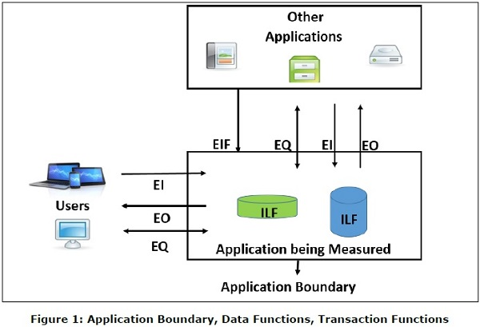
Function Point (FP)

Slide 6
External inputs (EI)
An external input (EI) is an elementary process that processes data or control information that comes from outside the application boundary
The primary intent of an EI is to maintain one or more ILFs and/or to alter the behavior of the system
Data may come from a data input screen or another application.
An EI is how an application gets information
Example:
Data entry by users
Data or file feeds by external applications

Slide 7
External outputs (EO)
An external output (EO) is an elementary process that sends data or control information outside the application boundary
The primary intent of an external output is to present information to a user through processing logic other than, or in addition to, the retrieval of data or control information
The processing logic must contain at least one mathematical formula or calculation, create derived data, maintain one or more ILFs, or alter the behavior of the system
Example:
Those items provided to the user that generate distinct application-oriented data (such as reports and messages, rather than the individual components of these)

Slide 8
External Inquires (EQ)
An external inquiry (EQ) is an elementary process that sends data or control information outside the application boundary
The primary intent of an external inquiry is to present information to a user through the retrieval of data or control information from an ILF or EIF
The processing logic contains no mathematical formulas or calculations, and creates no derived data
No ILF is maintained during the processing, nor is the behavior of the system altered
Example:
Interactive inputs requiring a response

Slide 9
Internal Logical Files (ILF)
An ILF is a user-identifiable group of logically related data or control information maintained within the boundary of the application
The primary intent of an ILF is to hold data maintained through one or more elementary processes of the application being counted
Example:
Tables in a relational database
Files
Application control information, perhaps things like user preferences that are stored by the application

Slide 10
External Interface Files (EIF)
An external interface file (EIF) is a user identifiable group of logically related data or control information referenced by the application, but maintained within the boundary of another application
The primary intent of an EIF is to hold data referenced through one or more elementary processes within the boundary of the application counted
This means an EIF counted for an application must be in an ILF in another application
Example:
As for ILF, but maintained in a different system

Slide 11

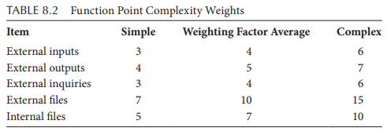
Unadjusted FP count (UFC)
A complexity rating is associated with each count according to function point complexity weights, below:
Example: UFC = 4N_{EI} + 5N_{EO} + 4N_{EQ} + 7N_{EIF} + 10N_{ILF}

Slide 12
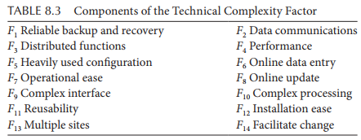
Technical Complexity Factors (TCF)
Technical complexity factors (aka. Value Adjustment Factor (VAF)) is a weighted sum of 14 components, given below:

Slide 13
Technical Complexity Factors (TCF)
Reliable Backup and Recovery: The application need reliable backup and recovery
Data Communications: The data and control information used in the application are sent or received over communication facilities.
Distributed functions: Distributed data or processing functions are a characteristic of the application within the application boundary.
Performance: Application performance objectives, stated or approved by the user, in either response or throughput, influence the design, development, installation and support of the application.
Heavily Used Configuration: A heavily used operational configuration, requiring special design considerations, is a characteristic of the application.
On-line Data Entry: On-line data entry and control information functions are provided in the application.
Operational Ease: Operational ease is a characteristic of the application. Effective start-up, backup and recovery procedures were provided and tested during the system test phase.

Slide 14
Technical Complexity Factors (TCF)
On-line Update: The application provides on-line update for the internal logical files.
Complex interface: The application requires complex interface for input/output
Complex Processing: Complex processing is a characteristic of the application.
Reusability: The application and the code in the application have been specifically designed, developed and supported to be usable in other applications.
Installation Ease: Conversion and installation ease are characteristics of the application. A conversion and installation plan and/or conversion tools were provided and tested during the system test phase.
Multiple Sites: The application has been specifically designed, developed and supported to be installed at multiple sites for multiple organizations.
Facilitate Change: The application has been specifically designed, developed and supported to facilitate change.

Slide 15

Technical Complexity Factors (TCF)
Each component is rated from 0 to 5, where 0 means the component is not relevant to the system and 5 means the component is essential.
TCF can then be calculated as:
VAF varies from 0.65 (if all Fj are set to 0) to 1.35 (if all Fj are set to 5)
FP = UFC × TCF
Min: 0 Max: 0.7

Slide 16

Example: Spell Checker
Checks all words in a document by comparing them to a list of words in the internal dictionary and an optional user-defined dictionary
After processing the document sends a report on all misspelled words to standard output
On request from user shows number of words processed on standard output
On request from user shows number of spelling errors detected on standard output
Requests can be issued at any point in time while processing the document file

Slide 17
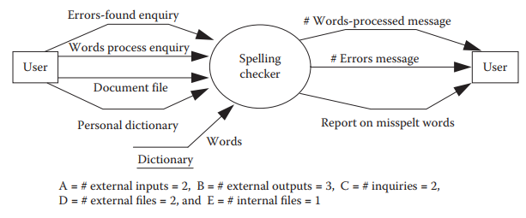
Example: Spell Checker
Spec to Diagram

Slide 18


Example: Spell Checker
Assume that:
F3, F5, F9, F11, F12, and F13 ------🡪 0,
F1, F2, F6, F7, F8, and F14 ---------🡪 3,
F4 and F10 ------🡪 5
FP = UFC * TCF = 58 * 0.93 = 53.94 ~ 54

Slide 19
FP
Suppose our historical database of project measurements reveals that it takes a developer an average of two person-days of effort to implement an FP.
Then we may estimate the effort needed to complete the spelling checker as 108 days (i.e., 54 FPs multiplied by 2 days each).

Slide 20
FP Advantages
Can be counted before design or code documents exist
Can be used for estimating project cost, effort, schedule early in the project life-cycle
Helps with contract negotiations
Not dependent on languages

Slide 21
FP Limitations
FP is a subjective measure: affected by the selection of weights by external users.
Problems with subjectivity in the technology factor.
Problems with double counting.
Problems with subjective weighting.
Function point calculation requires a full software system specification. It is therefore difficult to use function points very early in the software development lifecycle.
Problems with changing requirements.
Not suitable for “complex” software, e.g., real-time and embedded applications.

